Slide 1
Operationalisation Strategy for Auto Lending
Consumer Lending Products / External Network Sales
October 2024

Slide 2
WHAT is the scenery: The Greek Auto Market
 | Total ('000 units) | % Retail | %Fleet
2018 | 104 | 47,00% | 53,00%
2019 | 115 | 48,50% | 51,50%
2020 | 81 | 57,80% | 42,20%
2021 | 101 | 50,20% | 49,80%
2022 | 105 | 48,00% | 52,00%
2023 | 134 | 42,00% | 58,00%
Ytd 2024 | 108 | 44,00% | 56,00%
1. The mix is changing in favor of Fleet Market
2. Dominant player in auto Retail Market
3. Laggard player in auto Fleet Market

Slide 3
Greek Auto Market Mapping

Slide 4











Auto Finance Market Perspective in Greece
IB FINANCING
RETAIL AUTO LOANS
E2E DIGITAL AUTO LOAN Used car marketplace with digital CJ embedded finance
RETAIL OPERATING LEASING ​
SB & DEALER FINANCING
SB FINANCING: FLEET AUTO LOANS ( RaC & Commercial vehicles)
DEALER FINANCING: - STOCK FINANCE - FLOOR PLAN FACILITY New & Used Cars
FLEXIBLE RENTAL PROGRAMS (Maas) Through dealers
RETAIL OPERATING LEASING Through dealers
Limiτed/specific digitized aspects

Slide 5
WHY the scenery is Changing: Global Dynamics and Trends
Used car market with significant increase
Used car market further fueled by more flexible offerings (leasing, balloon payments etc.)
Operating Leasing is a fast-growing market
Flexible offerings without the customer having to bear the residual value risk and long-term commitment
“Mobility-as-a-Service” model (MaaS) emerging
Combine different modes of transportation on a single platform (car sharing schemes, subscription-based, etc.)
Creating their own online B2C marketplaces
Digital Integration with Online Car Buying Platforms
Fully digitalized customer experience, online purchasing and exhaustive financing options

Slide 6






Digitisation in Auto Lending: key trends
Mobile First
Personalized Loan Offers
Apply & manage a loan application entirely from a smartphone
Personalized loan terms based on customer’s need, credit profile & financial situation
Seamless Integration with Dealerships
Digital ecosystem in which loan application process is integrated with car dealerships for a smoother purchase process
Best Practices
for a Digital Auto Lending Market
Transparency
Keeping customers informed through every step of the loan process
User-Friendly Application Process
Robust Security
Simplified process via online platform. Simplified data entry, Real-time decisions, Integrated advanced digital technologies, such as using AI, ML
Use of advanced identity verification tools, such as biometrics, VIN, multi - factor authentication
Sources:
https://defisolutions.com/answers/auto-finance-market-trends-and-predictions/
https://www.linkedin.com/pulse/banking-trends-automotive-industry-how-skipthedealershipsca-jjuqc
https://www.measureone.com/blog/auto-financing-trends-2024-2025-future-of-auto-loans

Slide 7
ERB Pillars for Change & Growth
Process
Credit Policy
Product Development
short term
short term
medium term
Dealer Financing
Dealer Floor plan: platform & flow improvements
Individuals’ financing
C2C Used Car loan
Digital Auto Loan
“Mobility-as-a-Service” model
New Operating Leasing platform available to Dealers via:
New cooperation schemes with 3rd parties & capitalize “Know – How” (i,.e. FlexCar,, Instacar)
New On Us platform (PoS Cash Advance-like) / fleet management by 3rd party
New ‘Arval – like’ commercial agreement
2. Used Cars marketplace
Time-to-market (RBB & IB): flow & documents optimization (OTP or signature pad use, etc)
SLA Review (RBB & IB)
Online wizard tool for customers’ preapproval upon expression of interest
New unified onboarding & Origination platform similar to competitor’s (Santander)
Dealer Financing
Stock Finance:
integrate to all eligible Dealers
review policy & documents
Floor plan: review policy
RBB Financing
Fleet Finance (RaC): review policy & documents
Individuals’ financing
Used cars policy review
Increase max loan amount:
> € 50k for premium Brands
Increase automated approvals vs. credit overrides delivered manually
long term
long term

Slide 8






Current Operating Model B2B: gap in provided services
B2B Components
Current State
Future State
Stock Finance
Fleet Auto Loans
Retail Operating Leasing via Dealer
E2E Digital Auto Loan
Retail Auto Loans
Notes:
888888

Slide 9


Future Operating Model D2C : gap in provided services
D2C Components
Current State
Future State
Mobility Ecosystem platform
MaaS ( subscription model car sharing, after sales service)
Used car marketplace, Customer loyalty schemes
Retail Operating Leasing

Slide 10



Next Steps
Team
Recruit the right staff
Across ERB/Retail
Short term tasks
Prioritise & assign initiatives
Streamline
Define pillars
Identify streams & substreams
Transformation: integrate as a distinct / separate project category

Slide 11
Mobility Strategy
Appendixes

Slide 12
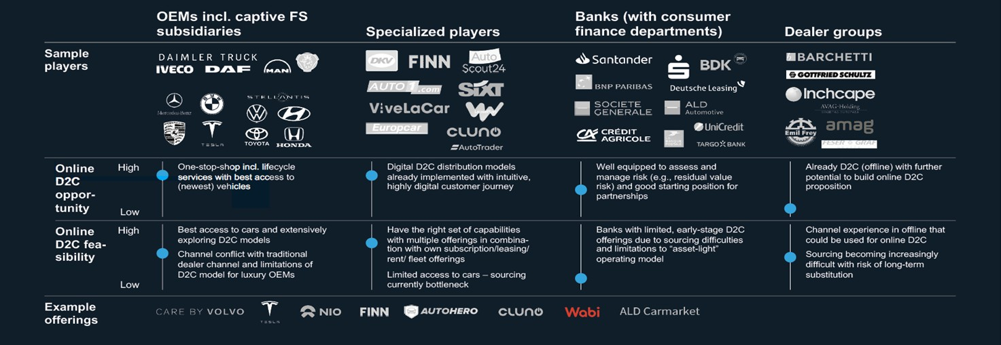
WHY the scenery is Changing: Global Dynamics and Trends (2/2)
Source: McKinsey team analysis

Slide 13




Ways to Response to Change
Customer financing experience improvement, enhancing loyalty
New financing propositions development
Support dealers to omnichannel transition
Expect complete online applications and self-services
Seek for personalized products and attractive prices
Need for seamless channel experience
Mobility services through education, platforms and products
Mobility fleet ownership opportunity
Platform Providers
Leasing Companies
Banks
1
2
3
4
5
6
Motor Finance
Lenders
OEMs
Customers
Take advantage of continuous communication with customers
Commercial opportunity for both fleets and infrastructure (Credit Agricole with FCA Bank)
Capitalize on detailed insight into client and in-car systems related data
Build on existing billing capabilities for
new mobility products
Leverage existing customer channels
Rapidly growing market, CAGR of 4% until 2025 within European Market
Compelling fleet transition offering for
electrification of vehicles
Partnership ecosystem development for end-to-end solutions
Sources: 1. “A revolution for motor financing”, KPMG, December 2019, 2. “Digital by design”, Deloitte, 2020, 3. “Automotive Captive Finance: Trends 2020”, Capgemini Consulting, 2017,
4. “European Auto Finance: Initiatives for the next level of mobility value capture”, McKinsey & Company, 2022

Slide 14



Global Auto Lending research: key findings
Product Presentation: Business & Personal Finance (Loan, leasing, Buy Back etc) / Insurance
Selection & customization: vehicle & financial solution
Quote – Offer / Online application: waiting for result - end of digital journey
Finance Agreement: @dealer’s premises
Post Finance & After Sales Services: payments, instalment change request , update personal data
Toyota Finance
Phygital Loan
Financial Solutions to end customer (physical / legal entities) & Dealers
Program comparison
Data entry on unified platform / Financial services software
Use of Web browser based eSign (Signature pad device abolished)
Post disbursements services
Santander@UK: Digital personal loan for new / used car purchases – without user authentication
Santander
No Dealer’s involvement
Specific purpose loan
Risk Based Pricing
Barclays
Digital Personal Loan

